Slide 1
Operating Systems
SENS-3513
Week: 1
Introduction to Operating Systems, Computer system structure
Operating System Concepts
9th edition
Silberschatz, Galvin & Gagne
John Wiley & Sons
2013
Dr Nauman Mazhar
Faculty of Information Technology (FIT)
University of Central Punjab (UCP)

Slide 2
Instructor
DR NAUMAN MAZHAR
Associate Professor, Faculty of IT&CS
PhD (Computer Engineering)
  Computer Networks & Security
  CASE, Islamabad, research element in Michigan State University, USA
MS (Computer Engineering)
  Computer Networks & Security
  IOWA State University, USA
BE (Avionics Engineering)
  College of Aeronautical Engg (CAE), PAF Academy Risalpur (NED Univ)
nau.maz@ucp.edu.pk

Slide 3
Introduction
Course Objective:
“Learn the basic concepts & principles involved in
design, implementation & functioning
of an OS”
  Understand: what is an OS, what is its structure, &
  what are its core functions / services
  Analyze: the algos & techniques used to implement the
  core functions & services
  Apply: the OS system calls & APIs to develop & manage
  efficient software solutions
3

Slide 4
Course Contents
Introduction & Basic Principles
  What is an OS
  Computer system organization & architecture
    system boot process
  OS modes of operation
  Computing environment
  Interrupts & interrupt servicing
  Protection in OS – dual mode operation
  OS services
  User interface – cmd line, GUI
  Programmer interface – system calls
4

Slide 5
Course Contents
Process Management
  Process creation/termination, process states
  fork() & exec() system calls
  Orphan & Zombie processes
  Coding examples
Inter-Process Communication
  IPC methods
  Anonymous & Named pipes
  Shared memory
  I/O redirection & Pipes on terminal
  Coding examples of I/O & pipes
5

Slide 6
Course Contents
CPU Scheduling
  Preemptive & Non-preemptive scheduling
  Scheduling criteria
  Scheduling algos
  FCFS, SJF, SRTF, Priority, RR, MQS, MFQS
Threads
  Single-threaded vs Multi-threaded process
  Multithreading models
  Thread libraries - Pthreads creation
  Thread issues
  Implicit threading
  Thread pools
6

Slide 7
Course Contents
Process Synchronization
  Critical Section problem
  Software solution - Peterson’s algo
  Hardware solution - Disabling Interrupts, Atomic Instructions
  Hybrid solution - Mutex, Semaphore
  Classical problems of synchronization
    Producer-Consumer Bounded-Buffer
    Readers-Writers Dining-Philosophers
Deadlocks
  Deadlock characterization
  Deadlock handling
    Prevention, Avoidance, Detection, Recovery
7

Slide 8
Course Contents
Memory Management
  Address translation
  Overlays & Swapping
  Contiguous & Non-contiguous memory allocation
  Paging & Segmentation
  Paged-Segmentation
  Virtual memory
  Demand paging
  Page replacement algorithms
  Allocation of page frames
  Thrashing
8

Slide 9
Course Learning Outcomes
 | CLO | Taxonomy Level | PLO Mapping
CLO-1 | Describe the core functionalities of operating systems, its architectural components, and goals involved in OS design. | C2 | 2
CLO-2 | Explain the fundamentals of Process Management, including process structure, scheduling algorithms and inter-process communication (IPC). | C2 | 2
CLO-3 | Apply the concepts of memory management including advance techniques of paging, segmentation and virtual memory. | C3 | 3
CLO-4 | Implement thread based programming solutions, as well as classical synchronization problems (e.g., producer-consumer, reader-writer) using programming constructs like mutexes and semaphores. | C3 | 3
9

Slide 10
Books Recommended
Text:
Operating System Concepts (9th ed)
  by Abraham Silberschatz, Peter B. Galvin, Greg Gagne
Operating System Internals & Design Principles (5th ed)
  by William Stallings
Ref:
Modern Operating Systems (3rd ed)
  by Andrew S. Tanenbaum
10

Slide 11
Course Methodology
Lectures
14 power point lectures
Study relevant sections of Text / Ref books
Assignments
Assignments done individually / groups
To be submitted exactly when due
5% marks deduction per day for being late
After one week – Not Accepted
Exam Pattern
Exams to include complete material in covered chapters
MCQs, short answers, problems, analysis/design questions
11

Slide 12
Grading Policy
Quizzes ………. 04 15%
Assignments ………. 04 15%
Class participation ..….…. 05%
Mid-exam ..….…. 25%
Final-exam .……… 40%
Distribution is tentative and flexible
12

Slide 13
Academic Honesty
Your work in this class must be your own
If students are found to have:
  collaborated excessively, or
  copied/shared answers
For the first infraction…
  all involved will, at a min, receive grades of 0
Further infractions…
  will result in failure in course
13

Slide 14
Attendance Policy
Strictly in accordance with the Univ policy…
Office Hours
Office : C-Block, Room 101
Office Hours : ???
14

Slide 15
Lets Start the Course…
15

Slide 16
Lecture Outline
What is an OS
Why do we need an OS
Computer System Organization
  system boot – simulation
Computer System Architecture
  single processor, multi-processor, clustered
OS Modes of Operation
  multiprogramming
  multitasking
Computing Environment
16

Slide 17
What is an Operating System
“OS is a program that acts as an intermediary between
computer user & computer hardware”
Operating system goals…
  execute user/system level programs
  solve user’s computing related problems
  make computer system convenient to use (abstracts h/w)
  use computer hardware in an efficient manner
OS → program that runs at all times on a computer
  (known as kernel)
17

Slide 18
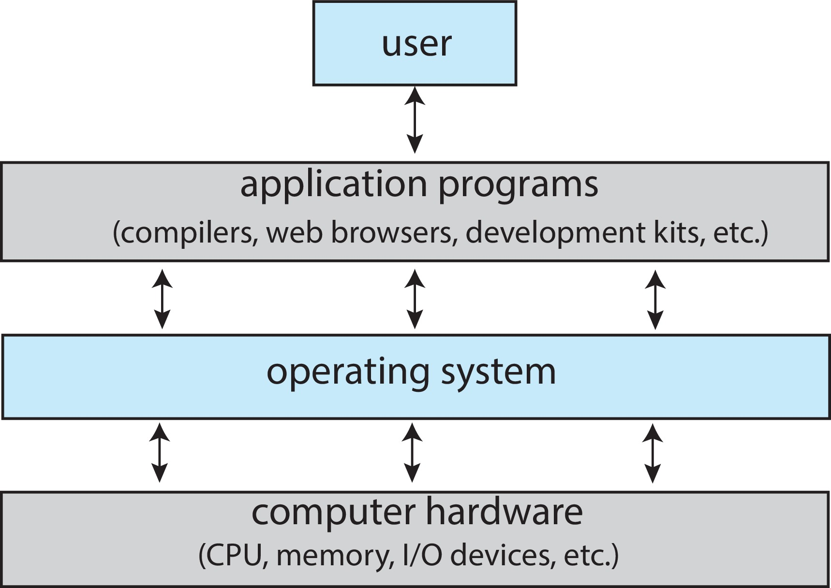
What is an ‘OS’
Computer system divided into four components:
people, machines, computers
perform specific tasks for end-users
  system s/w to control & coordinate use of computing resources
basic computing resources
18

Slide 19
What is an ‘OS’
“Code” that sits between:
  programs & hardware
  between different programs
  between different users
What does it do:
provides orderly & controlled access/allocation of resources
(processor, memory, hard disk, I/O devices)
Resource management thru sharing, in two ways:
Time Multiplexed (CPU sharing, printer sharing)
Space Multiplexed (memory, hard disk)
19

Slide 20
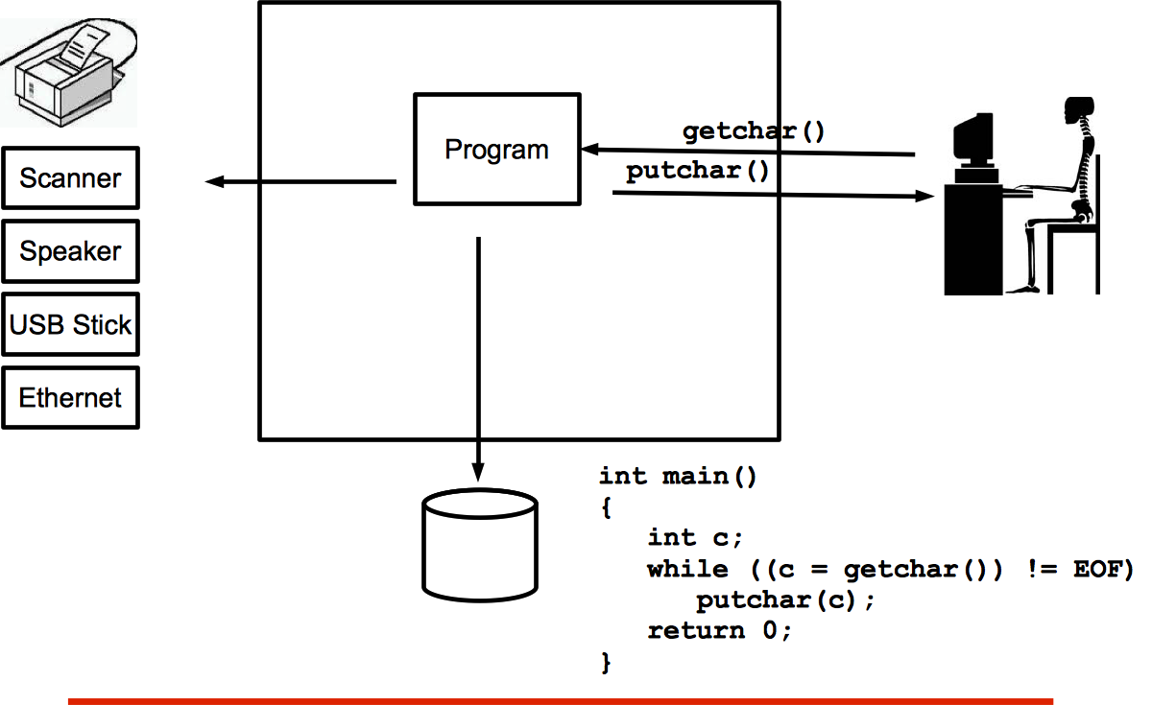
OS – an Abstraction
if single user or
program
Notes:
Virtually all computers provide a mechanism by which other modules (I/O, memory) may interrupt the normal sequencing of the processor.
Interrupts are provided primarily as a way to improve processor utilization.
For example, most I/O devices are much slower than the processor.
Suppose that the processor is transferring data to a printer using the instruction cycle scheme described earlier.
After each write operation, the processor must pause and remain idle until the printer catches up.
The length of this pause may be on the order of many thousands or even millions of instruction cycles.
Clearly, this is a very wasteful use of the processor.

Slide 21
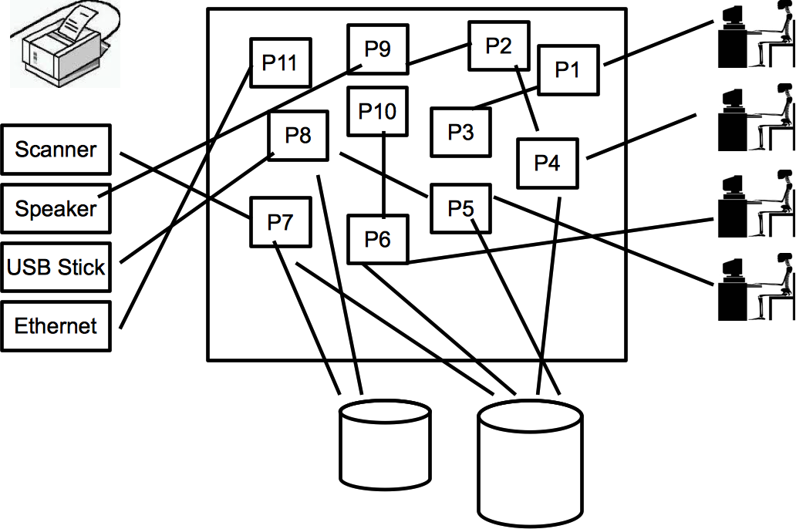
OS – an Abstraction
if multiple users,
programs, files, devices
who manages all resources, and
connects programs with various devices…???
Notes:
Virtually all computers provide a mechanism by which other modules (I/O, memory) may interrupt the normal sequencing of the processor.
Interrupts are provided primarily as a way to improve processor utilization.
For example, most I/O devices are much slower than the processor.
Suppose that the processor is transferring data to a printer using the instruction cycle scheme described earlier.
After each write operation, the processor must pause and remain idle until the printer catches up.
The length of this pause may be on the order of many thousands or even millions of instruction cycles.
Clearly, this is a very wasteful use of the processor.

Slide 22
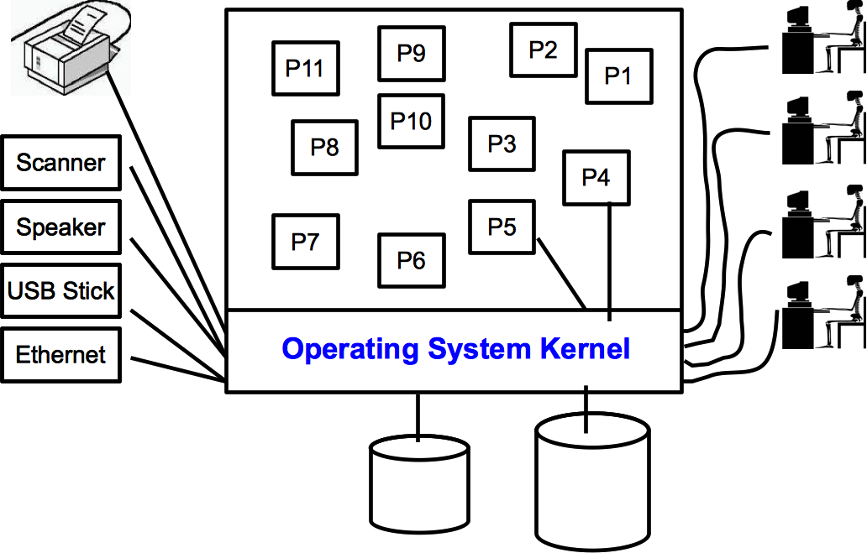
OS – an Abstraction
all interactions thru kernel
programs request services from OS
OS provides services
Notes:
Virtually all computers provide a mechanism by which other modules (I/O, memory) may interrupt the normal sequencing of the processor.
Interrupts are provided primarily as a way to improve processor utilization.
For example, most I/O devices are much slower than the processor.
Suppose that the processor is transferring data to a printer using the instruction cycle scheme described earlier.
After each write operation, the processor must pause and remain idle until the printer catches up.
The length of this pause may be on the order of many thousands or even millions of instruction cycles.
Clearly, this is a very wasteful use of the processor.

Slide 23
Operating System Definition
No universally accepted definition…
A good approximation…
“Everything a vendor ships when you order an OS”
    included features vary
    size from MBs to GBs – CLI vs GUI
Along with kernel, two other types of programs:
  Application prog – perform user specific tasks
  (browsers, games, word processor, spreadsheet )
  System prog – convenience & support of OS
  (file utilities, compilers, shells, system monitors)
23

Slide 24
Why do we Need an OS
OS is needed to provide the following services:
Process management
CPU scheduling
Inter-process communication
Process synchronization
Deadlock handling
Memory management
File system management
Storage management

Slide 25
Name some OS!
MS Windows
Unix System V
BSD
Sun Solaris
Irix
Linux
MacOS
Android from Google
iOS from Apple
Symbian from Nokia
BlackBerry from RIM
Windows 10 Mobile

Slide 26
  Computer System Organization
26

Slide 27
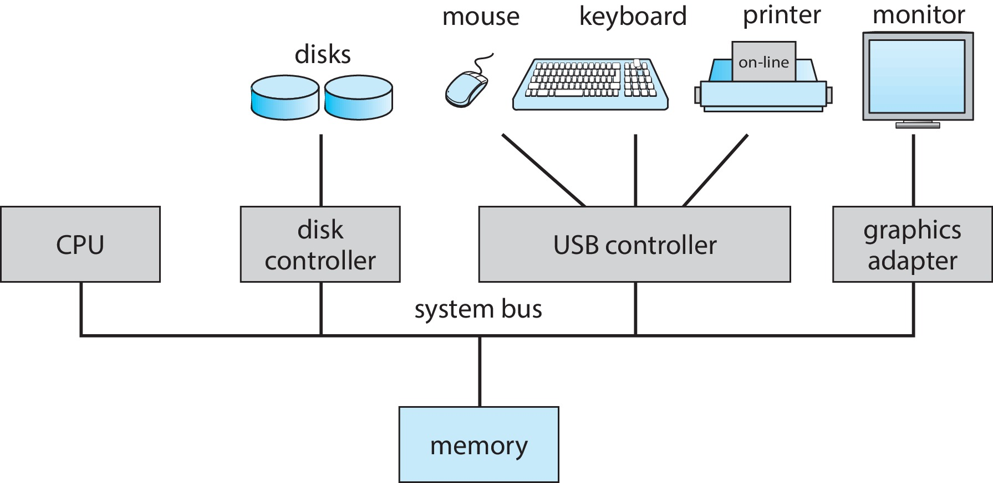
Computer System Organization
General purpose computer system…
  CPU, memory, devices & device controllers
  devices attach to specific controllers
  device controllers connect to CPU through a common bus
  bus provides access to shared memory
27

Slide 28
Computer System Organization
Device controller – hardware component to handle / control a particular device type
Device driver – part of system software to allow OS to interact with a device controller
CPU & device controllers can execute in parallel
  orderly access to shared memory → memory controller
Device controllers have local buffers
  I/O is between device & local buffer of controller
  CPU moves data between local buffer & main memory
Device controllers use interrupts to get CPU attention
28

Slide 29
Computer System Organization
Boot Process
  at system startup, kernel is loaded into memory & executed
    (bootstrap program on ROM)
  kernel executes – starts providing services to system/users
  some services also provided by system processes – daemons
    (load at boot time, started by kernel, & run in background)
Once booted, OS kernel enters an idle loop, waiting for events
Occurrence of event → signaled by Interrupt
  Hardware Interrupt – from devices external to CPU
  Software Interrupt – from programs running on CPU
29

Slide 30
Interrupt Handling
When CPU receives Interrupt :
  currently executing program stops
  control transfers to a fixed address in memory
  Interrupt Service Routine (ISR) executes
  takes interrupt specific action
After servicing interrupt :
  interrupted instruction resumes
  address of interrupted instruction had earlier been saved
    as return address, on system stack
30

Slide 31
Instruction Execution
To run a program, it must be brought into memory
  CPU can load/run program instructions only from memory
  an instruction comprises – opcode + operand
Instruction execution cycle – (Von Neuman architecture)
  fetch instruction from memory :
  store in internal register
  decode instruction :
  understand the operation
  may fetch operand from memory, & store in internal register
  execute instruction :
  perform required operation, store result in register/memory
31

Slide 32
Sample Instruction
Example CPU instruction with an opcode & operand :
Consider assembly Instruction: ADD R1, R2, R3
Opcode: ADD Operand: R1, R2, R3
(add contents of register R2 to contents of register R3,
and store result in register R1)
In machine code, instruction may become:
Opcode : 1001 (assume 1001 represents ADD ops)
Operand : 0001 0010 0011 (assume binary values represent
registers R1, R2, & R3)
Complete machine code instruction: 1001 0001 0010 0011
This would be decoded/executed by CPU
32

Slide 33
Instruction Execution Cycle
Addr 2³²-1
ALU
R0
…
R31
F0
…
F30
PC
memory
…
Data1
Data0
Inst237
Inst236
…
Inst5
Inst4
Inst3
Inst2
Inst1
Inst0
Fetch
Exec
CPU
Control
Unit
Execution sequence:
  Fetch instruction at PC
  Decode
  Execute (possibly using registers)
  Write results to registers/mem
  Repeat
PC
Addr 0
33

Slide 34
Storage Structure
Ideally, all programs must reside permanently in main memory
  but main memory is volatile & limited
  We need to have a storage hierarchy ;
  hard disk – RAM – cache – registers
Main Memory
  the only large storage media that CPU can access directly
  an array of addressable storage bytes
  random access & volatile
  temporary storage for loaded programs
  implemented in semiconductor technology – DRAM
34

Slide 35
Storage Structure
Secondary Storage – extension of main memory
  used for permanent storage for installed programs
  non-volatile, very large, relatively slower
Hard Disk Drives (HDD)
  rigid metal/glass platters with magnetic recording
  read/write head moves over spinning disk to read/write data
  relatively low access speed
Solid State Drive (SSD)
  semiconductor storage (NAND Flash chips)
  faster access speeds
  more robust than HDDs, as no moving parts
35

Slide 36
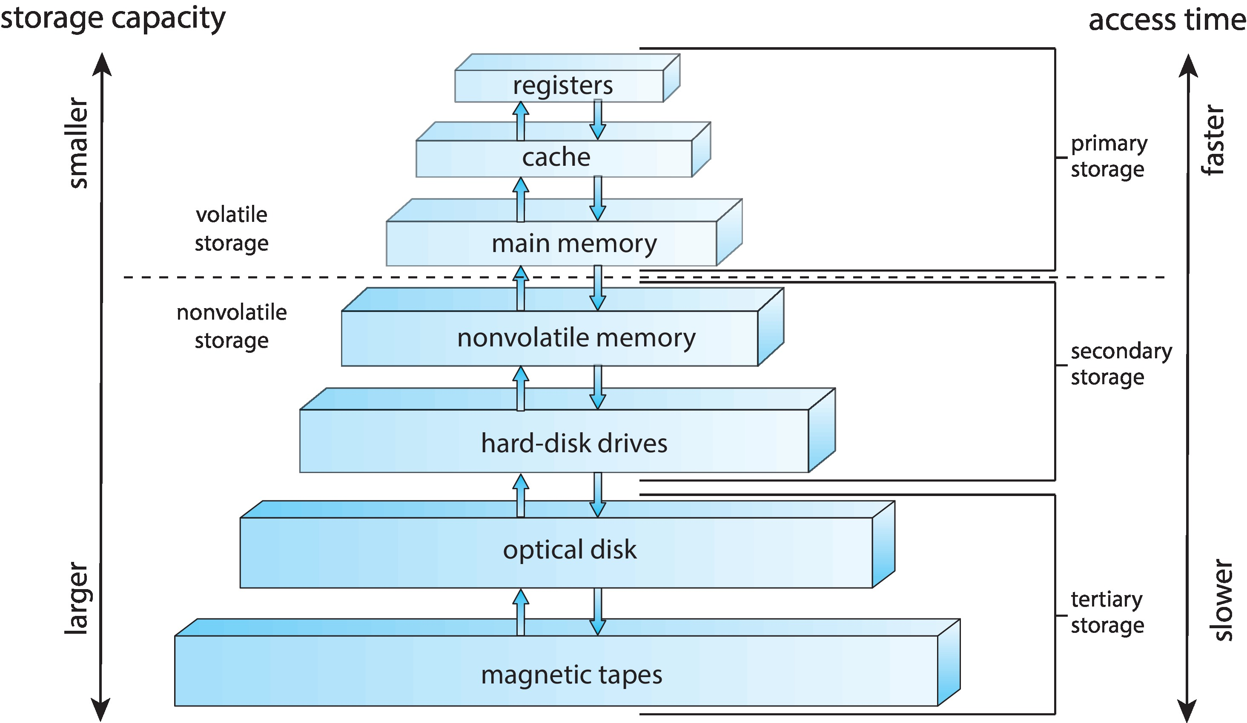
Storage Hierarchy
36

Slide 37
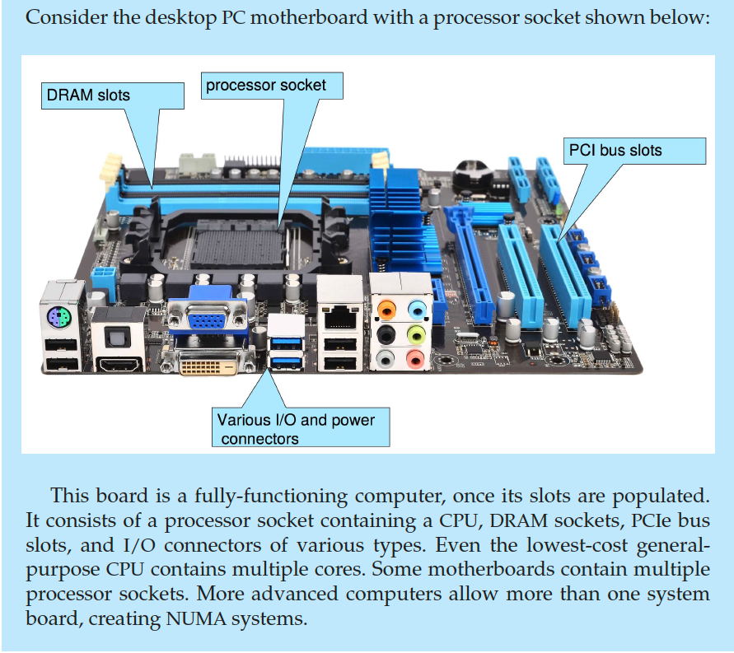
PC Motherboard
37

Slide 38
Computer Startup
Bootstrap Program is loaded at power-up, or reboot…
  Typically stored in ROM or EPROM, generally known as firmware (BIOS chip)
  Initializes various aspects of the system
  Loads OS kernel, & passes control to it
  Starts system execution
38

Slide 39
System Boot Simulation
Steps in Booting Process
https://www.youtube.com/watch?v=PSnGuvylWBI&ab_channel=ARTDETAILS
Program compilation / running etc
https://www.youtube.com/watch?v=3wuMRPhSNd0
Instruction execution cycle demo
https://www.youtube.com/watch?v=Z5JC9Ve1sfI
39

Slide 40
  Computer System Architecture
40

Slide 41
Computer System Architecture
Uni Processor systems
  system with one CPU – processing tasks performed sequentially
  CPU switches between tasks – illusion of parallelism
Multi Processor systems
  system with more than one CPU – parallel processing
  multiple tasks executed simultaneously
    higher throughput – more work done
    Increased reliability – graceful degradation (fault tolerance)
  CPUs may be on a single chip, single motherboard, or
  distributed across multiple nodes
41

Slide 42
Computer System Architecture
Approaches to Multiprocessing in a computer system:
Symmetric Multiprocessing – SMP
  “All processors treated equally – identical in H/W & capability”
  tasks assigned dynamically to any available core – load balancing
Asymmetric Multiprocessing – AMP
  “Processors not treated equally – may have different capabilities”
  one processor designated as "master"
  others as "slaves", with limited responsibilities
  master performs task scheduling, & resource allocation to slaves
42

Slide 43
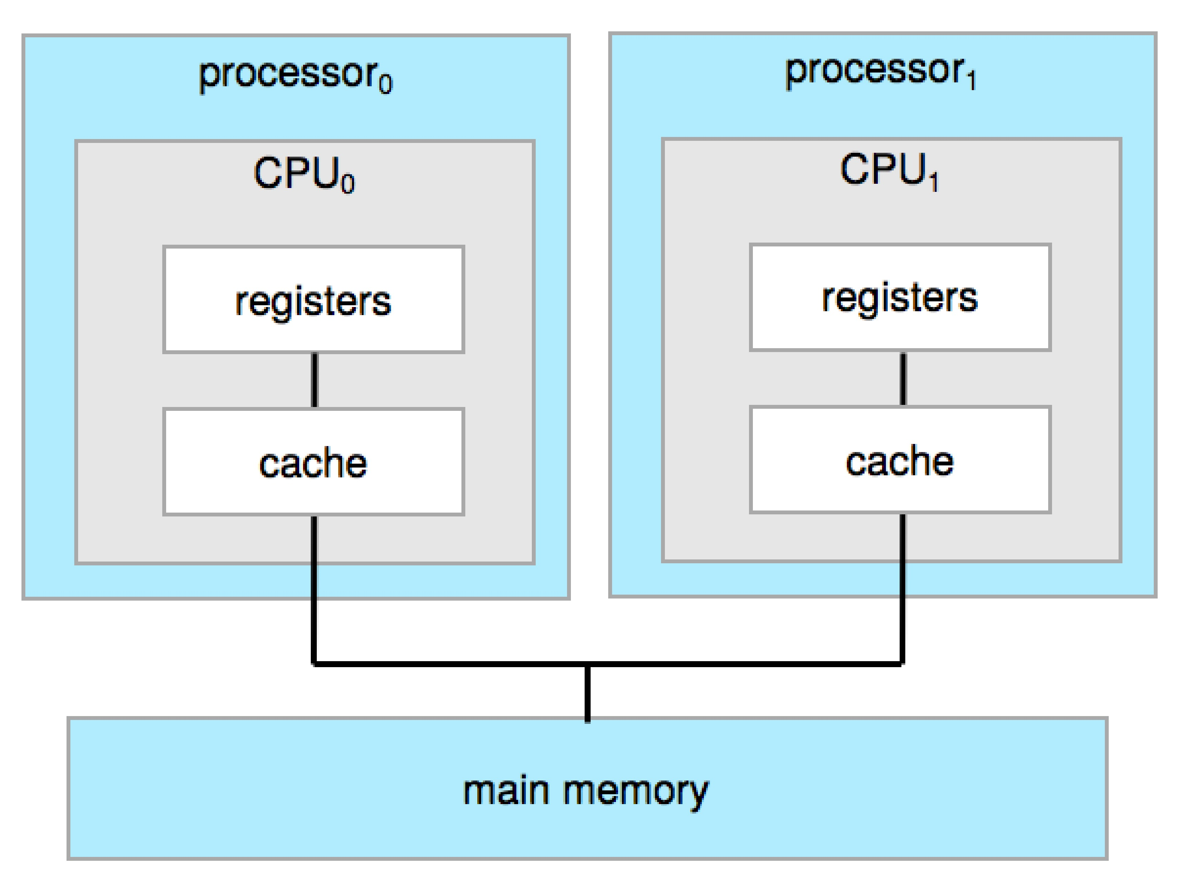
Symmetric Multiprocessing Architecture
Single Core system
Single computing core on one chip
Each core has own register set,
local cache
43

Slide 44
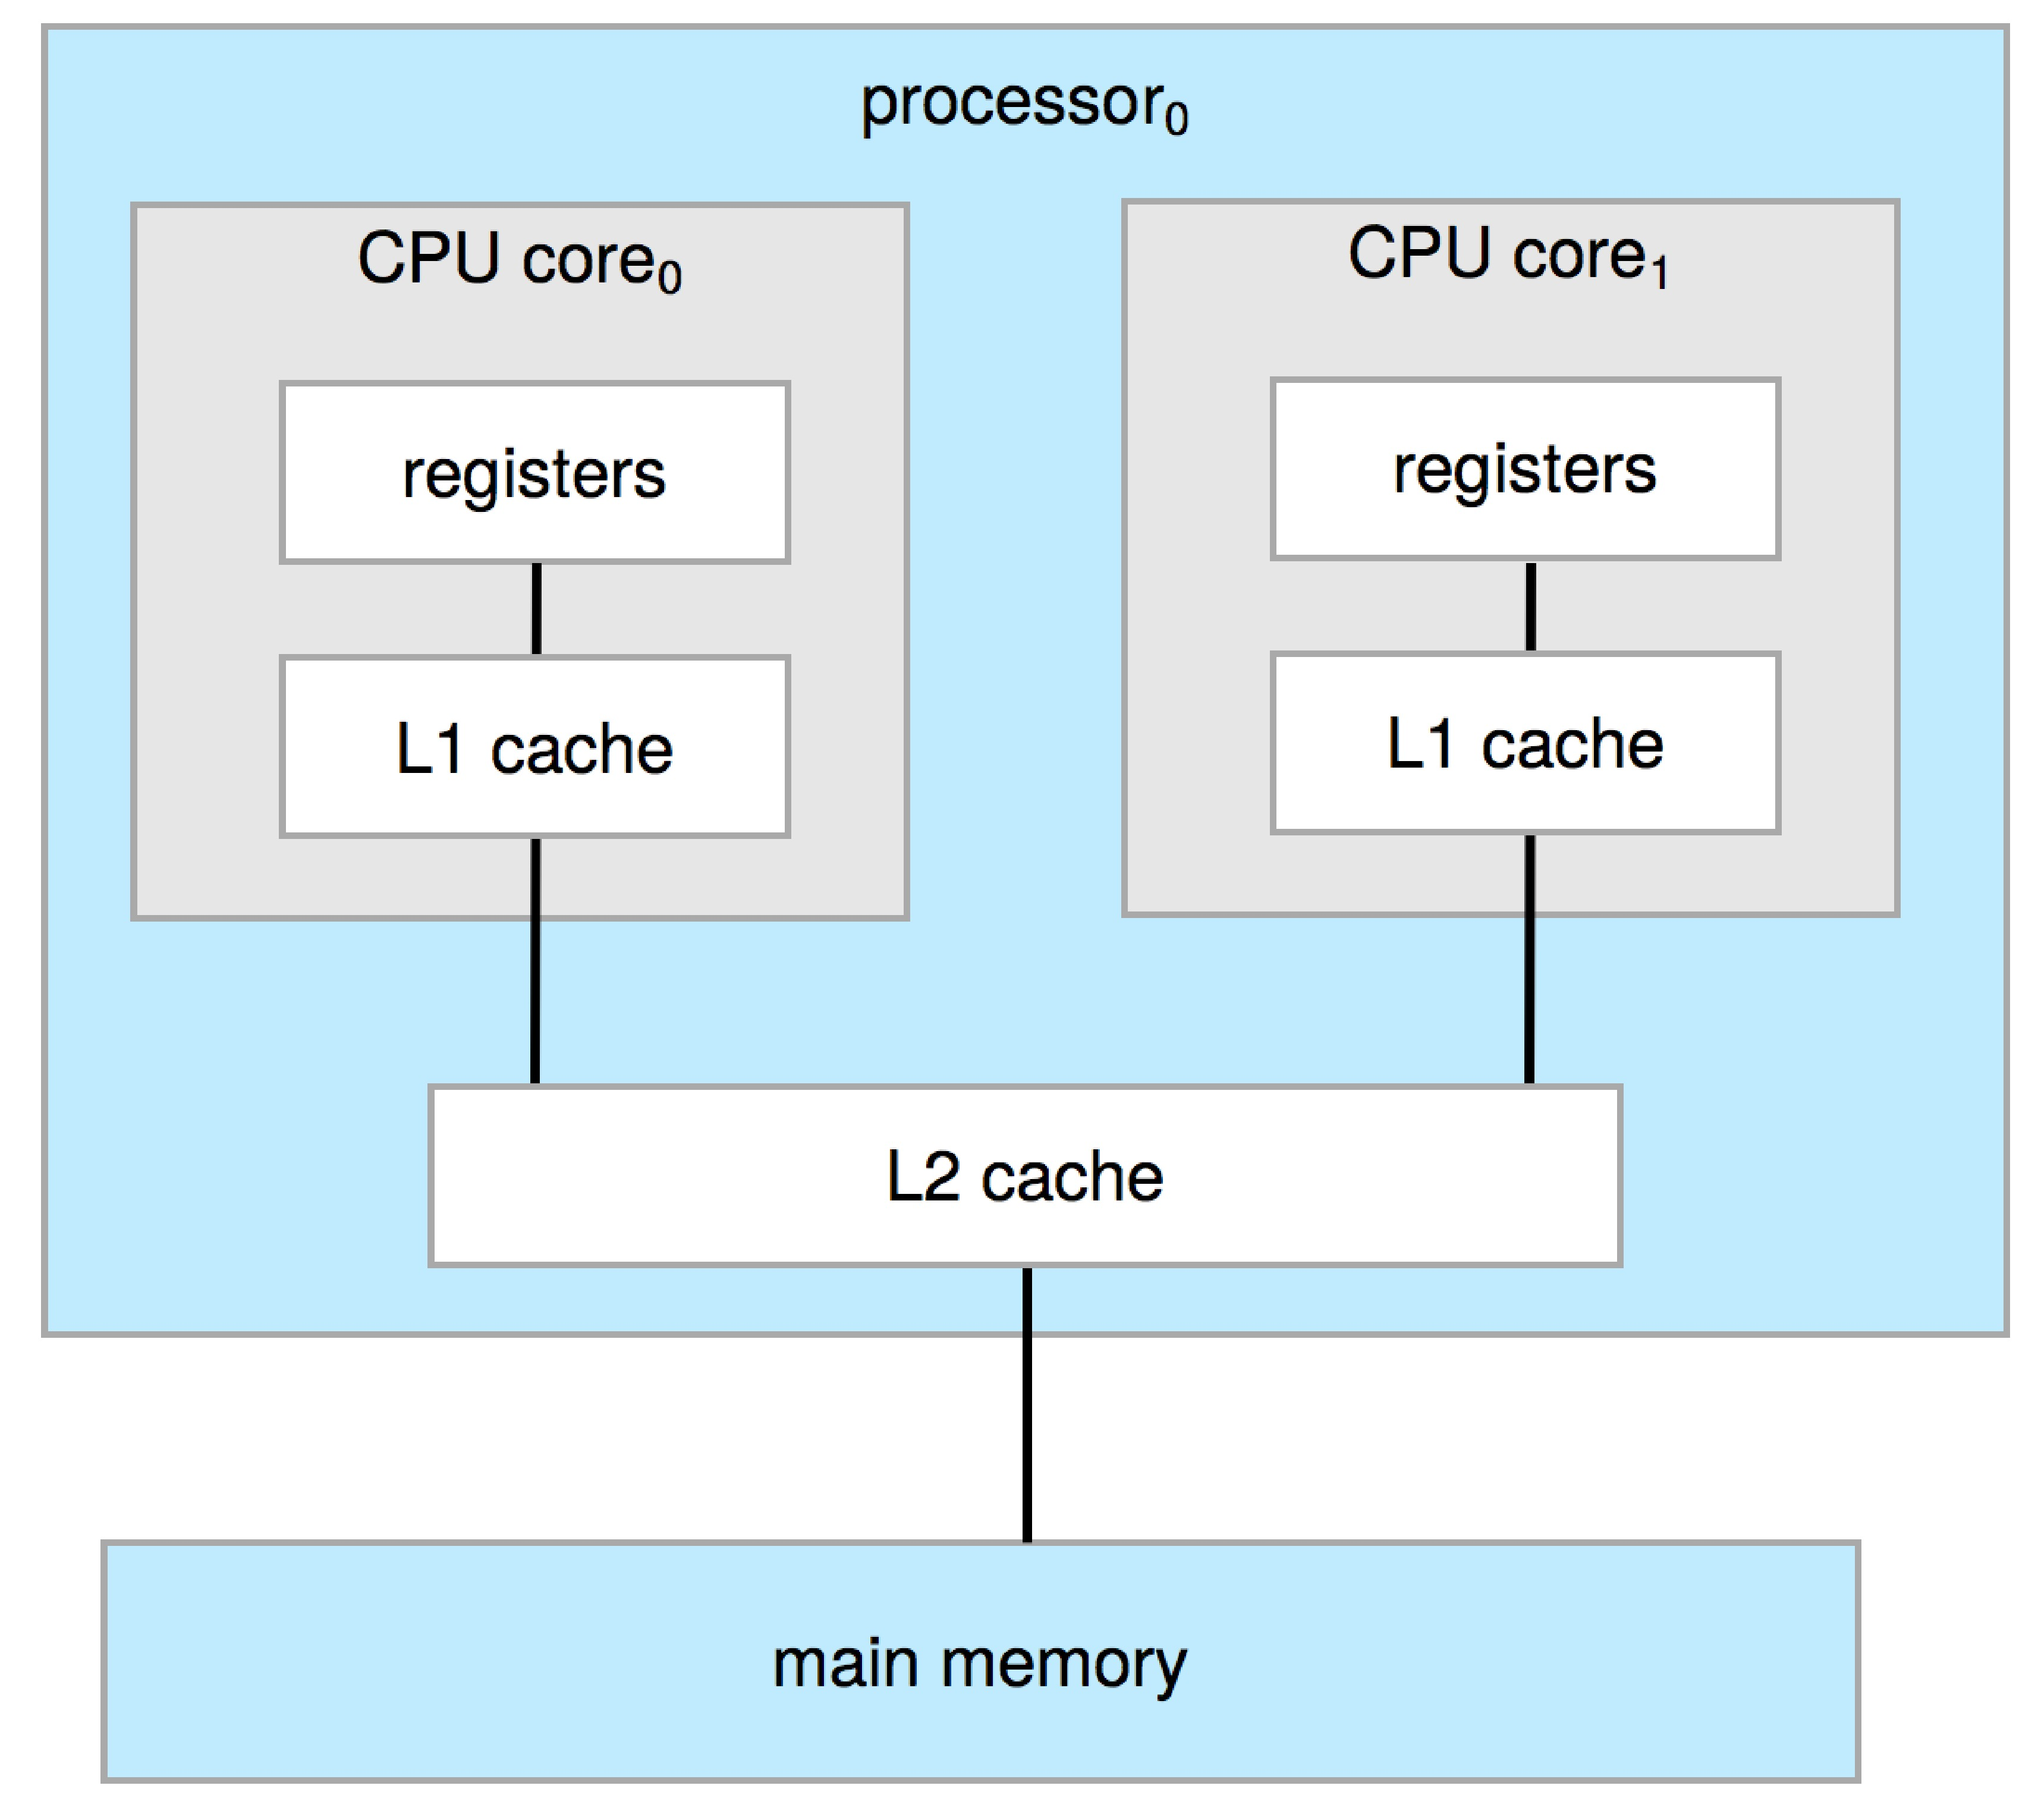
Dual Core Design
Dual Core system
Two computing cores on same chip
Each core has own register set,
local cache
Also, a shared cache
Multicore system
multiple computing cores on same chip
44

Slide 45
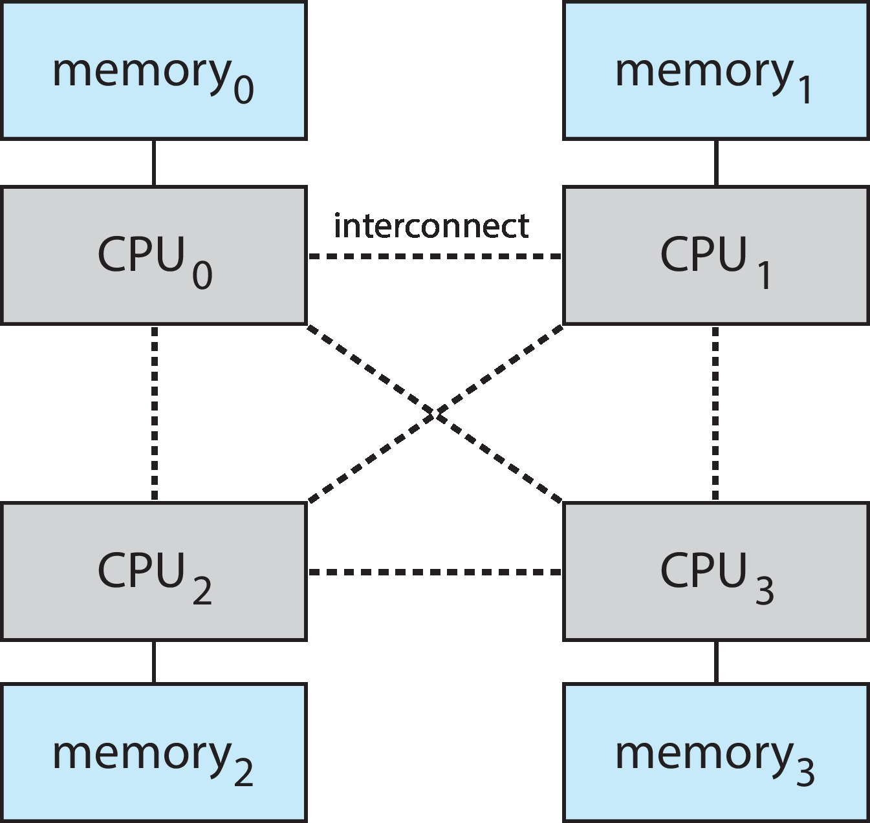
Non-Uniform Memory Access System
System having multiple processors & memory modules, distributed
across motherboards
  CPUs have Non-uniform memory access times
  fast access to own local memory
  slow access to other CPUs shared memory
NUMA systems designed to reduce access
latency
  optimize memory access
  make it appear as single,
  unified system
45

Slide 46
Clustered Systems
Multiple individual systems, connected via high speed N/W
Work together as single system for high performance
  share disk space – linked via SAN (storage area network)
  fault tolerant – configured to survive failures
  Symmetric Clustering – multiple nodes run applications,
  monitoring each other
  Asymmetric Clustering – one machine in hot standby mode
Need to manage access to data on shared disks to ensure data consistency
Apps specifically written for parallel/distributed computing
46

Slide 47
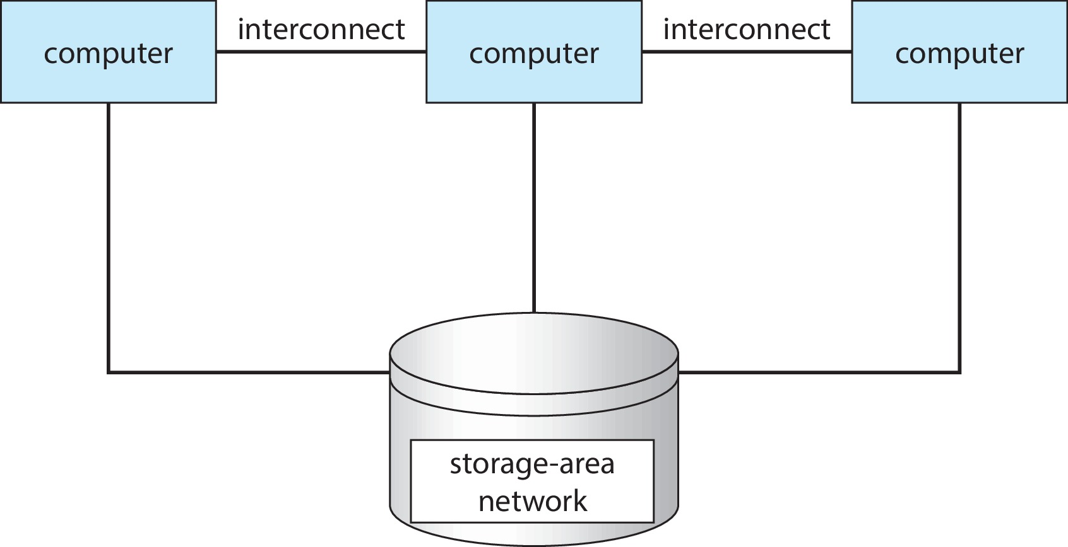
Clustered Systems
47

Slide 48
Modes of Operation of an OS

Slide 49
Multiprogramming
Multiprogramming
Execution of multiple jobs at the same time,
so that CPU always has one to execute
  single process cannot always keep CPU busy
  a process often has to wait for I/O operation completion
Multiple processes need to be brought in memory
  memory is limited, cannot hold all jobs in system
Processes kept on disk, waiting for memory allocation – Job Pool
  OS selects the job to bring into memory – Job Scheduling
When job has to wait for I/O, OS switches another job
  CPU would remain idle, if no multiprogramming
System resources utilized effectively – No User Interaction
49

Slide 50
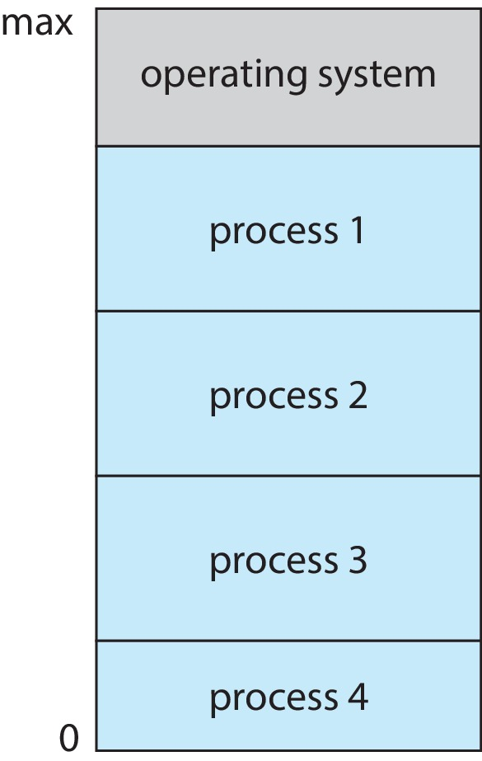
Memory Layout - Multiprogramming
50

Slide 51
Multitasking (Timesharing)
Multitasking
Execution of multiple jobs at the same time,
so that system appears to perform tasks simultaneously
  tasks executed concurrently
Several jobs ready to run at same time → CPU Scheduling
CPU switches jobs so frequently, so fast,
that each user can interact with his job while it’s running
  allows User Interaction with system
  response time < 1 second
If processes do not fit in memory → Swapping moves them in & out of memory
51

Slide 52
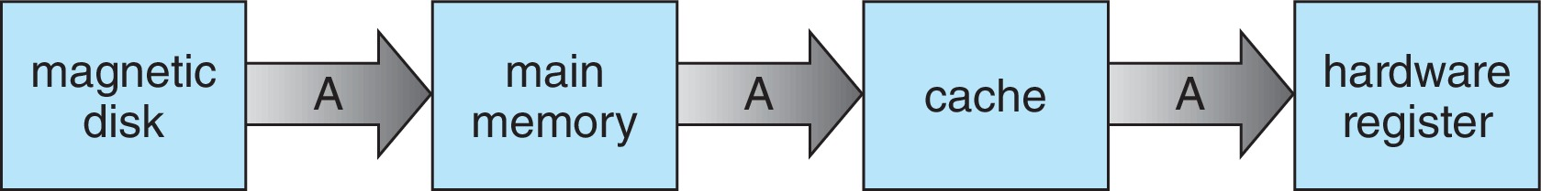
Issue in Multiprograming / Multitasking
In storage, same data may appear at different levels
Multiprogramming & multitasking environments must ensure using most recent data value
  no matter where it is stored in storage hierarchy
Distributed environment scenario is even more complex
  several copies of data at remote locations
  various solutions exist…!!
52

Slide 53
  Computing Environments
53

Slide 54
Computing Environments
Traditional
Distributed
  Client Server
  Peer-to-Peer
Mobile
Virtualization
Cloud computing
Real-time Embedded
54

Slide 55
Traditional Systems
Traditionally, there were stand-alone general-purpose machines
  but now all systems interconnect with others
  separation lines between computing environments are blurred
Networking is now ubiquitous
  even home systems connect to Internet via ISPs
  use firewalls for protection against cyber attacks
Mobile computers interconnect via wireless networks
Portals provide easy web access to systems
Thin clients provide various services, e.g, Web terminals
55

Slide 56
Distributed Systems
Multiple autonomous, possibly heterogenous systems, work together to provide unified set of services
  hosts communicate & coordinate to perform tasks
  use comm networks – most common TCP/IP Internet
Distributed systems widely used in various domains
  cloud computing, distributed DBs, CDNs, P2P networks
Network Operating System
  provides features across the network (file sharing)
  comm protocols allow processes on distributed systems to
  exchange messages
  illusion of a single OS across entire network
56

Slide 57
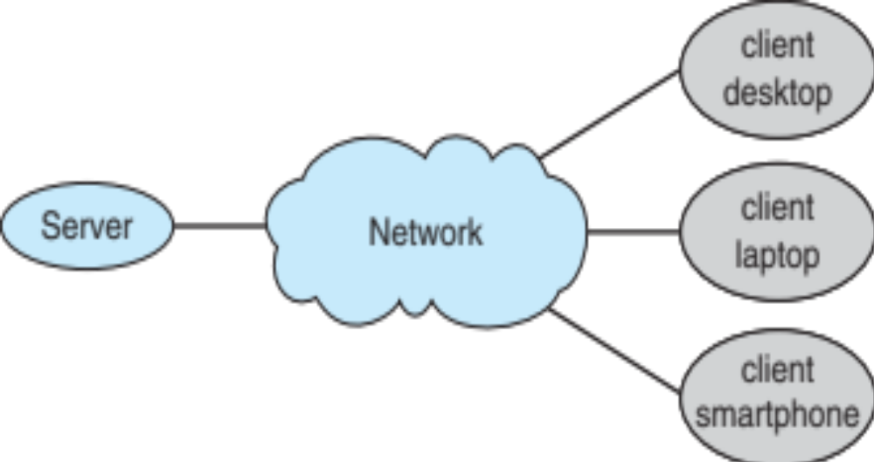
Client Server
Distributed system in which systems act as Clients & Servers
  clients make request to server
  servers respond to meet client request
  provides variety of services, resources, or data
Communication is over a network
  PAN, LAN, MAN, WAN, or the Internet
Processing is distributed
  client handles
  user interfaces
  server manages
  data storage &
  service provision
57

Slide 58
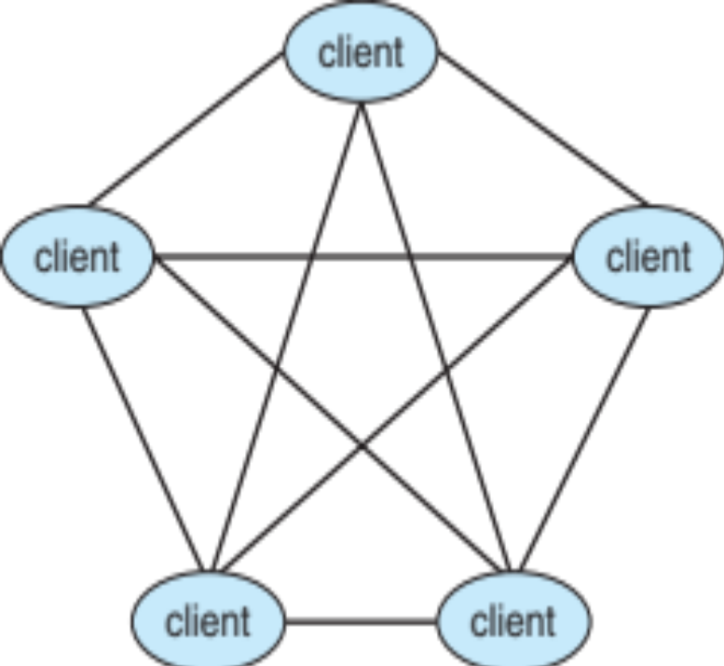
Peer to Peer
Another model of distributed system
P2P has no distinction between clients & servers
All nodes considered as equals
(act as client, server, or both)
Nodes join P2P network
  register services with central
  lookup service on N/W
  broadcast request for service, &
  respond to requests
  (via discovery protocol)
  Voice over IP – Skype
  File sharing – BitTorrent
58

Slide 59
Mobile Computing
Users can access & use digital services, data, & applications while on the move
  smartphones, tablets, smartwatches, etc
Mobile devices are typically small, lightweight, & portable
  small screens/battery, & low memory/processing
  need wireless comm facility (cellular, WiFi, BT)
  more OS features & sensors
  (GPS, accelerometers, gyroscope, proximity sensors)
Mobile OS design…
  optimized for small form factor devices
  driven by specific needs of mobile Apps
  e.g, Android, iOS
59

Slide 60
Virtualization
Allows creation of virtual instances of computing resources, instead of physical
  “multiple virtual machines (VMs) can run
  on a single physical system”
  abstracts underlying hardware
  VMs are isolated from each other
  each VM can have own OS, Apps & data
Virtual Machine Manager (VMM) – Hypervisor
  provides virtualization services
  intermediary layer between H/W & VMs
  manages & controls execution of VMs
  provides resource allocation & isolation
60

Slide 61
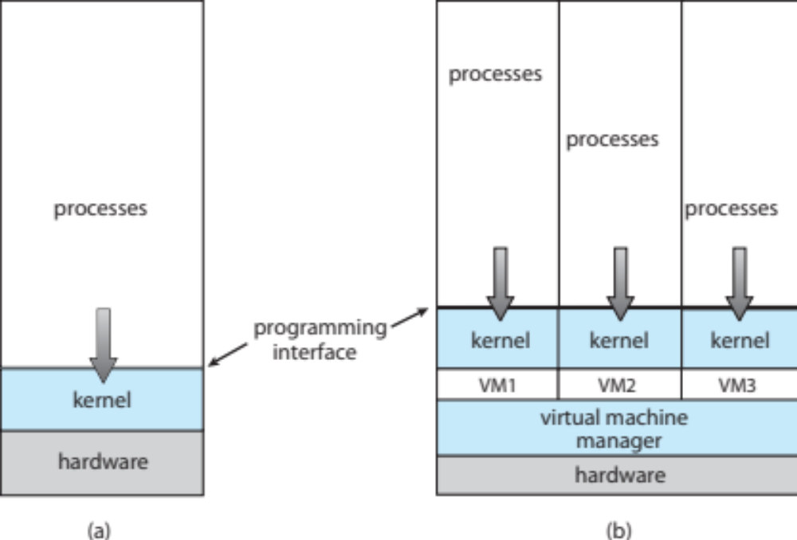
Virtualization
61

Slide 62
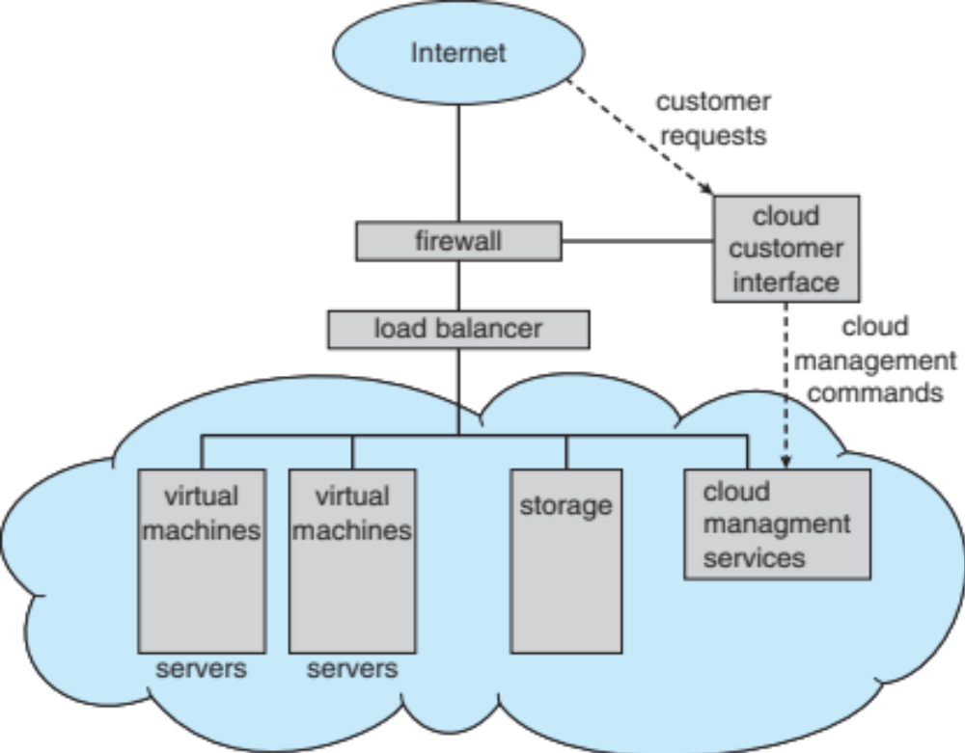
Cloud Computing
Delivers computing, storage, and even Apps as a service across a network
Comprises traditional OSs,
VMMs, and cloud
management tools
Internet connectivity
uses firewalls for
security
Load balancers
spread traffic
across
multiple
applications
62

Slide 63
Cloud Computing
Types of clouds:
  Public cloud – available via Internet to anyone willing to pay
  Private cloud – run by a company for own use
  Hybrid cloud – includes both public & private cloud components
SaaS – Software as a Service
  one or more Apps available via Internet (word processor)
PaaS – Platform as a Service
  software stack ready for application use via Internet (DB server)
IaaS – Infrastructure as a Service
  servers or storage available over Internet (storage for backup use)
63

Slide 64
Real-Time Embedded Systems
Specialized computing system, designed to execute specific tasks in a timely manner
  Real-time → system must respond to events
  within strict timing constraints
  some have OS – some perform tasks without an OS
  typical applications : automotive, consumer electronics, aerospace,
  industrial control, medical devices, etc
RTOS provide precise control over task execution
  manage tasks, scheduling & time constraints
  processing must be done within given constraints
  correct operation only if constraints met
64

